Slide 1
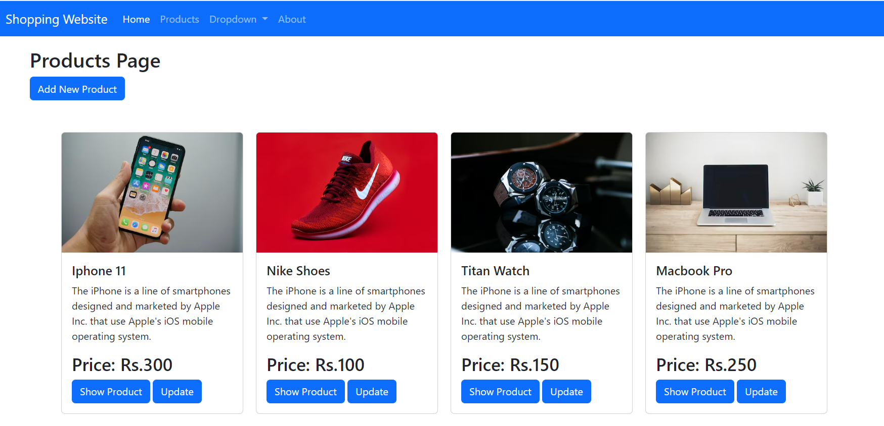
E-Commerce
Full Stack Project
https://e-commerce-s5hs.onrender.com/

Slide 2
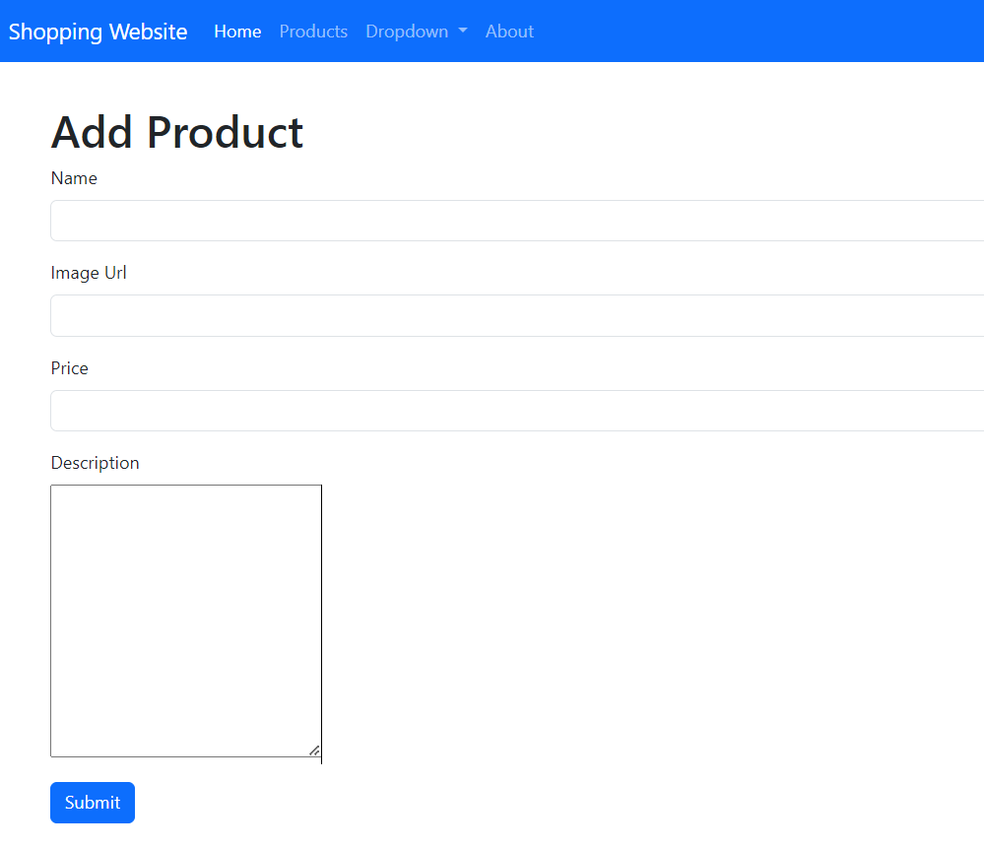
Add Products page

Slide 3
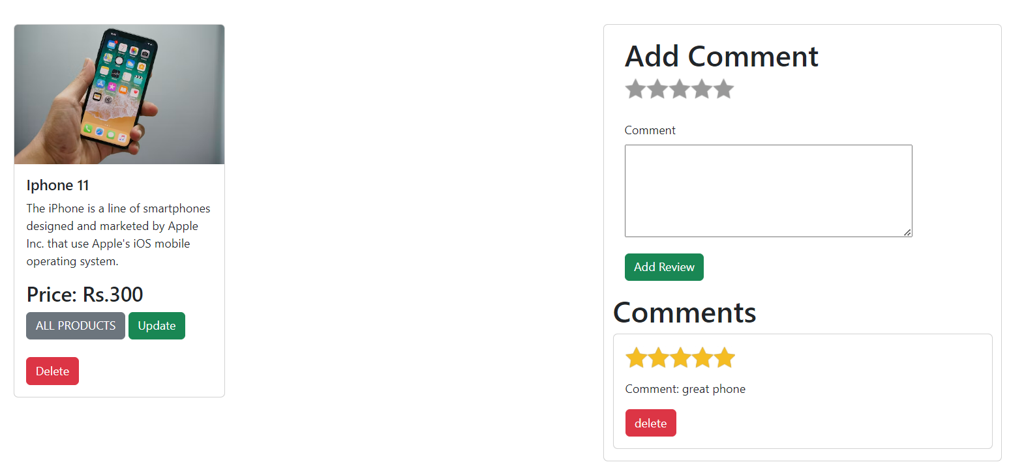
Show Product page

Slide 4
Features
Products Home Page
Add Product Page (Creation)
Show Product Page ( Retrieve )
Edit Product ( Updation and Deletion )
CRUD on MongoDb using Mongoose
Server using Express and NodeJS
Embedded JavaScript (EJS) Templating
Styling Using CSS and Bootstrap

